Slide 1
The NYCest Places
A deep dive into accommodations in New York City
By Saptarshi Saikia

Slide 2
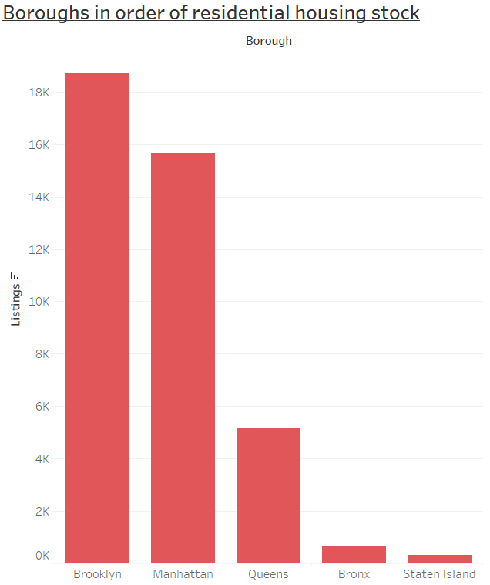
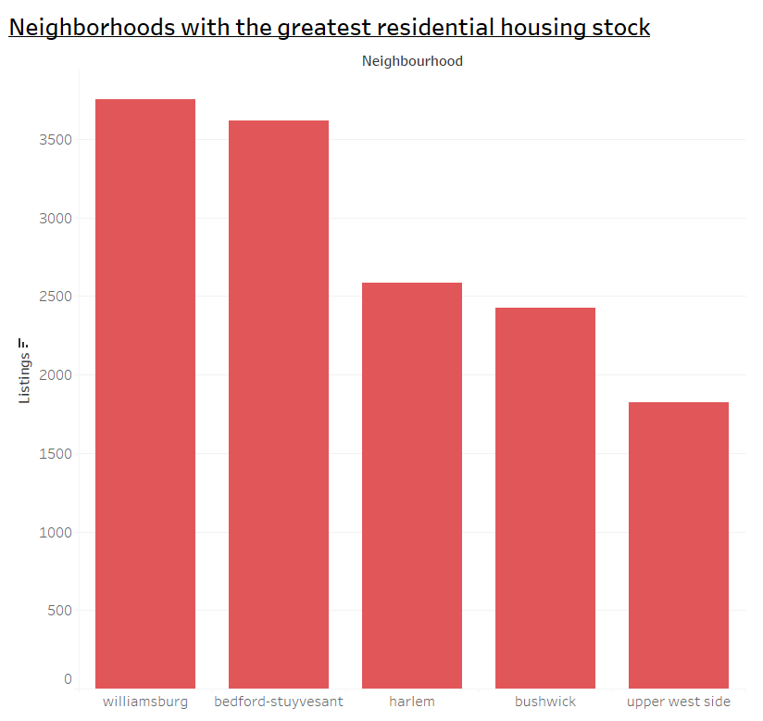
Brooklyn with the most
Brooklyn tops the charts with the most amount of accommodations listed followed by Manhattan.
Queens offers roughly one third of what's available in Manhattan but Bronx and Staten Island have very few properties listed.
Williamsburg and Bedford-Stuyvesant from Brooklyn take the top 2 spots among the neighborhoods followed by Harlem in Manhattan.

Slide 3
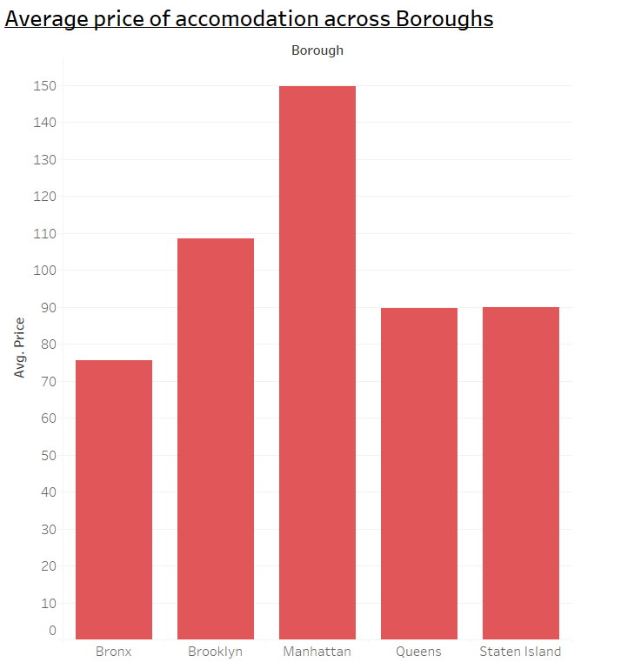
Manhattan’s expensive thrills
Manhattan is the most expensive borough to accommodate in New York.
Brooklyn here follows with being roughly 25% less pricey than Manhattan.
Queens and Staten Island almost have the same prices with Bronx having the cheapest places available.

Slide 4
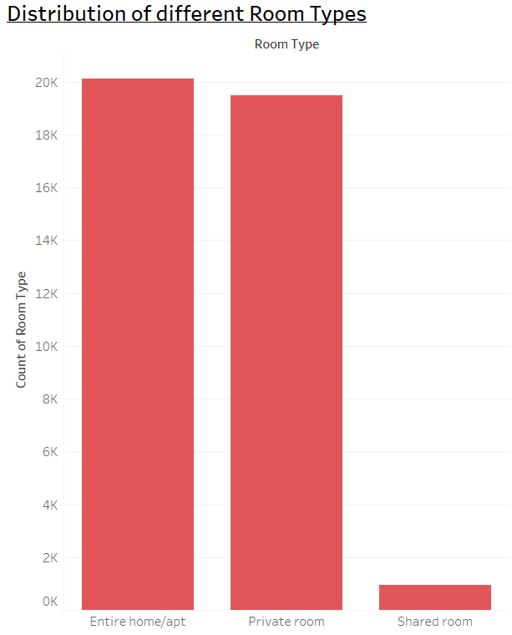
It’s a Full House
Looks like New Yorkers love renting out their entire place as it’s the most common room type. But the difference between it and private rooms available is very narrow. Only a fraction of the accommodations are shared rooms.
For someone whose rental is paid by the company and if they are travelling alone a private room would be more adequate as an entire home will be too big and it will save money. Shared rooms will also work if the traveller is comfortable.
And if instead of one individual it’s a large group then the company should opt for the entire home option.

Slide 5
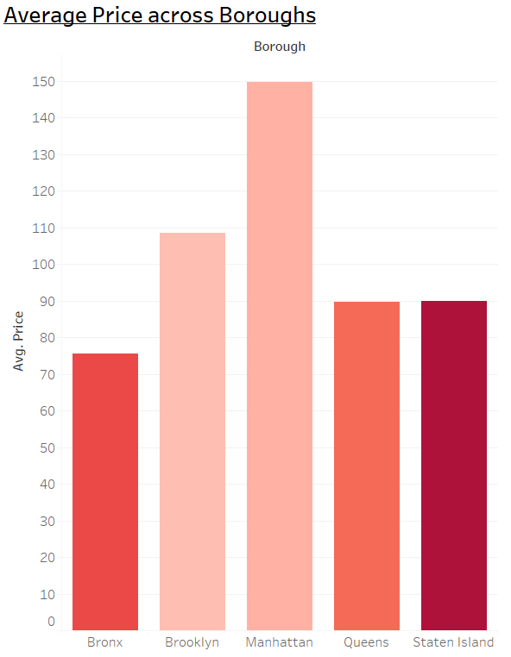

Staten Island Steers ahead
Manhattan comes out on top when we are considering the total revenue generated as it has the most expensive locations.
But when we consider the money earn per unit with respect to its availability throughout the year Staten Island comes out on top.
Despite having only a fraction of properties, Staten Island’s accommodations are available the most.

Slide 6
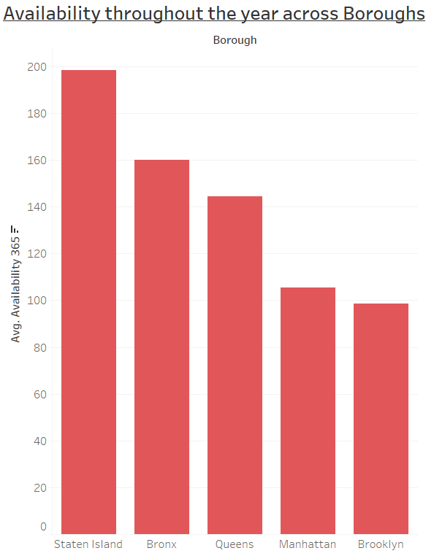
Who you gonna call?
As we just discussed Staten Island comes out on top with respect to availability. It’s properties are available almost 200 days a year on average.
It’s followed by Bronx and Queens who are very close to each other in these terms.
Lastly Manhattan and Brooklyn are at the bottom as it’s venues are very busy throughout the year.

Slide 7
Queens is the answer
Now considering all that we have discussed I believe Queens would be the ideal location for the company to expand into the residential accommodation market in New York City.
The average price of rentals in Queens is relatively cheap and it has a lot of properties available with respect to a cheaper option like Bronx. Queens also has its properties available for considerable days of a year.
Queens has a lot of major residential neighborhoods which will attract customers. Bronx and Brooklyn will be the other two boroughs to focus on as they also have similar neighborhoods.

Slide 8
Thank You

